Slide 1
Proposal for MTS Global Leadership Center *
MTS’s project with CLRC’s support officially launched 3/1/24
Aims to be a beacon of transformation in Christian leadership education and practice.
5 year plan to include webinars, workshops, conferences, mentorship programs, internships, courses, resource portfolio, published monographs, etc.
Serving the diverse needs of the local church by equipping Christ-centered leaders worldwide with the knowledge, skill, and character essential for transformative and visionary biblical leadership.
To cultivate Christian biblical leaders for excellence with the skills, knowledge, and godly character required to excel in ministry leadership …
Check point at least annually
* Global Leadership Center (GLC) used to be called Center for Advanced Global Leadership Studies (CAGLS).

Slide 2
MTS Global Leadership Center (GLC)
Mission: Our mission is to serve the diverse needs of the local church by equipping Christ-centered leaders, grounded in their God-given calling to ministry, with the knowledge, skills, and character essential for transformative and visionary biblical leadership.
Vision: The Global Leadership Center aims to be the go-to resource for MBI constituents and beyond for research, training, reflection, and conversation about ministry leadership.

Slide 3
Purpose
1. To equip Christian leaders with the skills, knowledge, and godly character required for excellence in ministry leadership, with a focus on developing leaders from diverse backgrounds and fostering leadership integrity in the global Church.
2. To encourage continuous growth in leadership through education, mentorship, and community engagement.
3. To promote a biblically grounded approach to leadership, evaluating contemporary best practices through the lens of Scripture.
4. To advance rigorous research and study biblically based leadership principles.
5. To cultivate a culture of prayerful dependence on God, emphasizing excellence, character, collaboration, and service among participants.

Slide 4
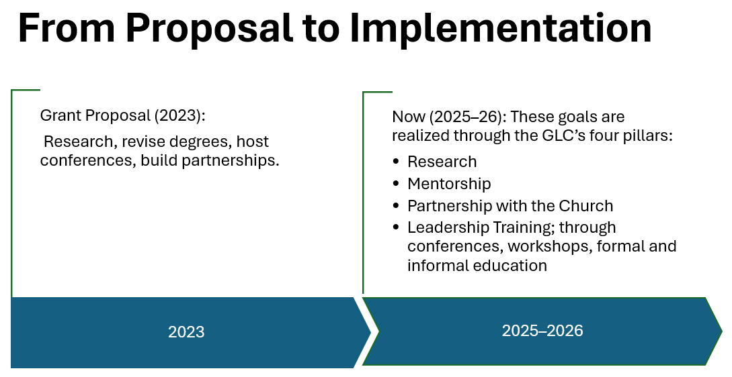

Slide 5
2026–2027 MTS GLC Strategic Initiatives
1. Global Leadership Media Initiative
Continue to develop additional content via the Global Leadership YouTube channel
Increase reach to 1,000,000 views and 10,000 subscribers
2. Leadership Research & Insights Initiative
Continue conducting new global leadership research in partnership with Moody faculty, DMin students, and U.S. and international ministry leaders.
Publish leadership reports, executive summaries, and practical ministry insights.
Expand research collaborations with strategic ministry partners and theological institutions.

Slide 6
2026–2027 MTS GLC Strategic Initiatives (cont.)
3. Leadership Formation & Mentorship Initiative
Expand global mentorship partnerships.
Continue strengthening mentorship opportunities for Moody students and international partners.
4. Global Partnerships & Leadership Collaboration
Strengthen collaboration with existing international partners.
Develop new strategic partnerships aligned with the Center's mission.
Encourage cross-cultural dialogue through collaborative leadership initiatives.
Expand opportunities for global leadership engagement across Moody's international network.
5. Leadership Resources & Practical Equipping
Expand the MTS GLC website into a centralized hub for leadership research, training, digital media, and practical ministry resources.

Slide 7
MTS GLC Action Items and Strategic Initiatives
(June 2026 Updates)
1. Global Leadership YouTube Series
4,080 YouTube subscribers
477,504 video views
25 videos (“shorts”) and 6 micro lectures
10 additional church leader interviews (Bangkok, Thailand)
2. Global Leadership Conference (June 2026)
200 senior ministry leaders from 27 countries participated
Major church networks & indigenous ministries worldwide represented

Slide 8
MTS GLC Action Items and Strategic Initiatives (CONT.)
3. Integrated Mentorship Initiative
MTS Student Pilot mentorship program set to launch in October 2026, with MTS faculty and students.
4. Leadership Research Project
Qualitative research in the form of individual interviews was conducted at the global leadership conference in Thailand, June 2026.
The following is a brief report from Research Coordinator, David Chizum:
  The role of church leaders as “mobilizers” and “catalyst
  Vision of a church is revealed by God
  Humility as the essential quality ; leadership is faithfulness and dependence upon God

Slide 9
MTS GLC Action Items and Strategic Initiatives (cont.)
Research Roadmap
February 2026 : research assistant
May 2026 : research plan, literature review and interview protocol complete
June 2026 : in-depth interviews begin; four continents represented
4th quarter : Research complete and findings documented for distribution
Research Purpose - To study :and understand the leadership attributes that set apart Christ-centered pastors across the world who led effective ministry transformations with biblical vision.
Research Significance - By identifying the attributes that distinguish these leaders, the study will contribute to a deeper understanding of effective pastoral leadership.
Research Proposal - The MTS Global Leadership Center will identify attributes of pastoral excellence that lead to transformative and visionary biblical leadership.

Slide 10
MTS GLC Action Items and Strategic Initiatives (cont.)
5. Global Leadership Fellowship Initiative
$2,500 annual student support fund
Partnered with Moody Publishers
Gifted the 200 Lifted Up attendees with two books:
  Moody Commentary
  Leadership as Identity
6. Leadership Development Workshops (2025–2026)
The April Leadership Development Workshop was a great success.
54 participants (18 in person, 36 online) led by Doug Schmidt, President of Pastor Thrive/Banabas Ministry and former Senior Pastor of Woodside Bible Church
Focus: Equipping church leaders to develop and strengthen mentorship relationships in their ministry

